Slide 1
Image Based Price Estimation Model
CSE 498: Deep Learning
Sponsor: Dr. Parv Venkitasubramaniam
Yan Huang, Vyshnavi Kondapalli, Xiang Gao, Lauri Soome

Slide 2
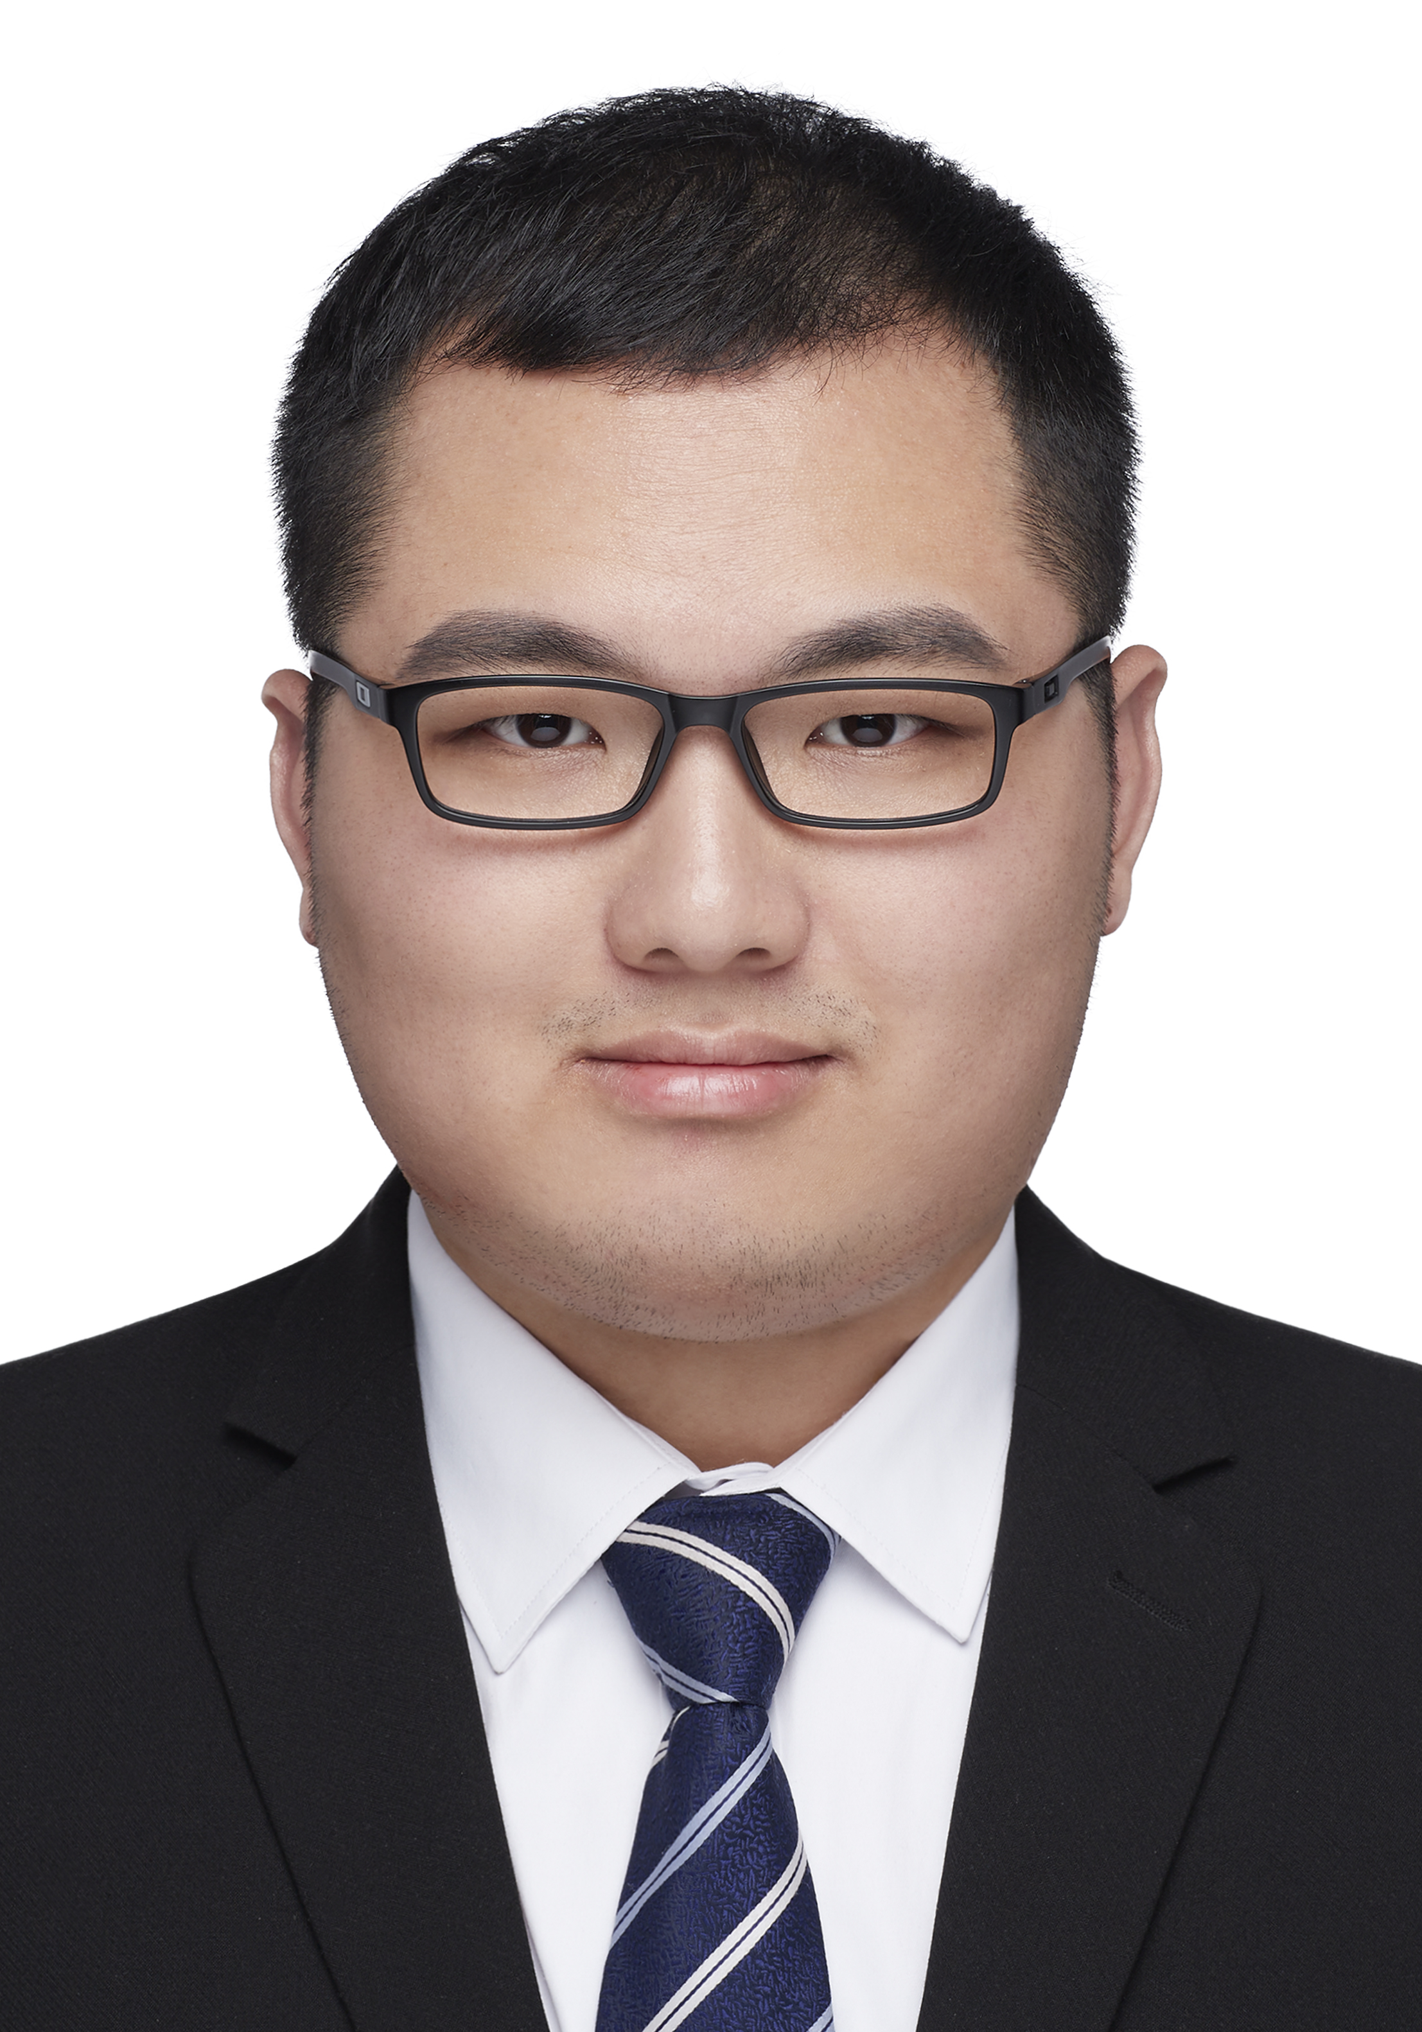



Yan H.
Meet the Team
Vyshnavi K.
Xiang G.
Lauri S.
M.S Data Science
yah423@lehigh.edu
M.S Data Science
vyk223@lehigh.edu
M.S Data Science
xig423@lehigh.edu
M.S Data Science
las623@lehigh.edu

Slide 3
Image-Based Price Estimation of Second-Hand Musical Instruments using Deep Learning
Large second-hand market for musical instruments
Buyers and sellers not aware of the fair prices
Aim to recommend prices for items based on images

Slide 4
Possible Challenges
Acquiring Valid Data
Taming Data Noise
Tailoring Deep Learning for a Regression Problem

Slide 5
Methodology
Literature Review
Data Collection & Processing
Benchmarking Baseline Model
Model Selection and Development
Inference, Analysis & Reporting

Slide 6
Project Management
Communication
Monitor and Follow the Progress
Weekly Progress Reports & Feedback
Monitor and Adapt to Changes
Partner with the Project Sponsor for Insight and Support

Slide 7
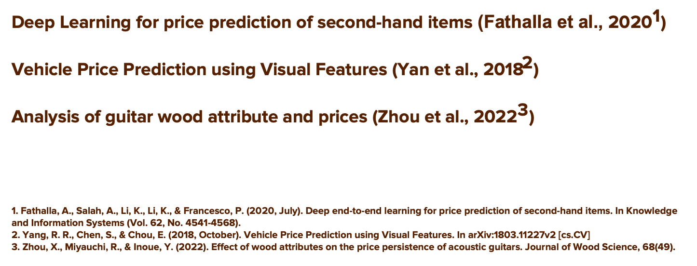
Relevant Papers
Deep Learning for price prediction of second-hand items (Fathalla et al., ${\text{2020}}^{\text{1}}$)
Vehicle Price Prediction using Visual Features (Yan et al., ${\text{2018}}^{\text{2}}$)
Analysis of guitar wood attribute and prices (Zhou et al., ${\text{20}\text{22}}^{\text{3}}$)
1. Fathalla, A., Salah, A., Li, K., Li, K., & Francesco, P. (2020, July). Deep end-to-end learning for price prediction of second-hand items. In Knowledge and Information Systems (Vol. 62, No. 4541-4568).
2. Yang, R. R., Chen, S., & Chou, E. (2018, October). Vehicle Price Prediction using Visual Features. In arXiv:1803.11227v2 [cs.CV]
3. Zhou, X., Miyauchi, R., & Inoue, Y. (2022). Effect of wood attributes on the price persistence of acoustic guitars. Journal of Wood Science, 68(49).

Slide 8
Time Plan
Week 4 – Proposal Presentation
Week 4 – Week 6 Methodology Research & Data Collection
Week 7 – Week 8 Benchmark Baseline Model
Week 8 – Midterm Presentation
Week 9 – Week 11 Model Selection & Improvement
Week 12 – Week 14 Inference, Analysis & Reporting
Week 15 – Final Presentation

Slide 9
Tasks
Management: Lauri
Research Methodology: Lauri & Vyshnavi
Data Collection: Xiang & Yan
Benchmarking Baseline Model: Lauri & Vyshnavi
Model Development & Improvement: Xiang & Yan
All: Inference, Analysis & Reporting

Slide 10
Questions?

